Slide 1
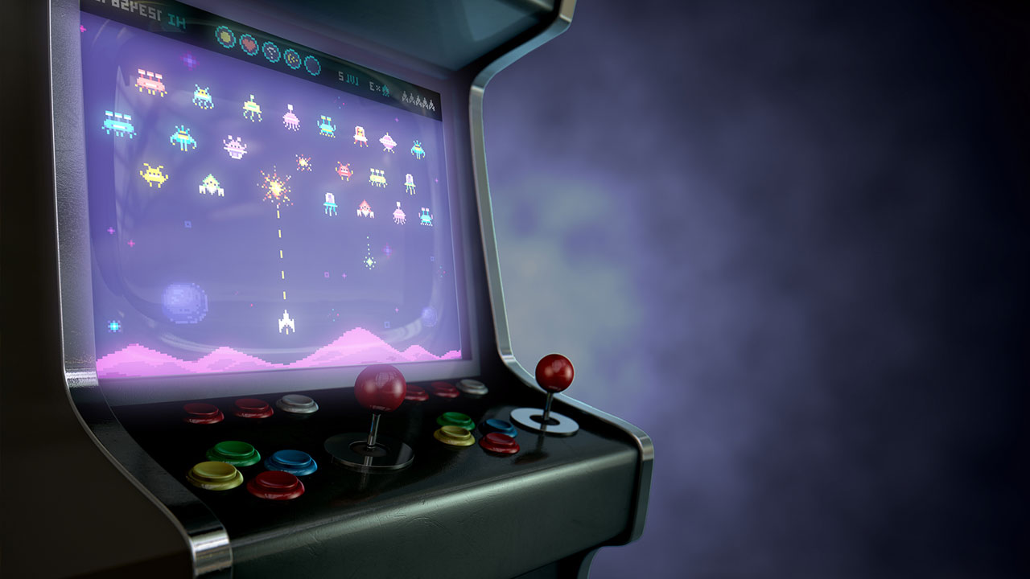
Interactive text-based game on Raspberry PI
By Ignacio Gonzalez, Timothy Wood and Andrew Garcia

Slide 2
Table of contents
01
04
02
05
03
06
Timeline
Challenges
Class Concepts
Improvements
Mechanics and Code Overview
Demo

Slide 3
Timeline
Define the project's scope, objectives, and requirements.
Arrange the different user-based decision pathways and flow of the program
Start setting up the main environment
Introduce multithreading and multiprocessing to handle different aspects of the game
Develop core game logic, setting, and features
Implement time-based events and test synchronization of multithreading
Implement and develop user interface for displaying all the game information and features
Refinement and implementation of final details, and Testing

Slide 4
Class Concepts
Locks | Creation of a lock for shared file, which allows both game scripts to communicate by reading file and writing to it.
Multiprocessing | We have 2 separate processes running, one of the Game and the other for the Map and Performance.
Multithreading | …
Synchronization Performance | Game with concurrent threads, which results in checking for overhead, lock contention, shared data protection and false sharing.

Slide 5
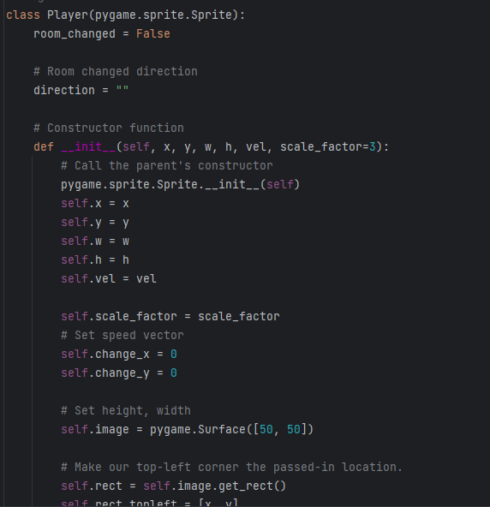
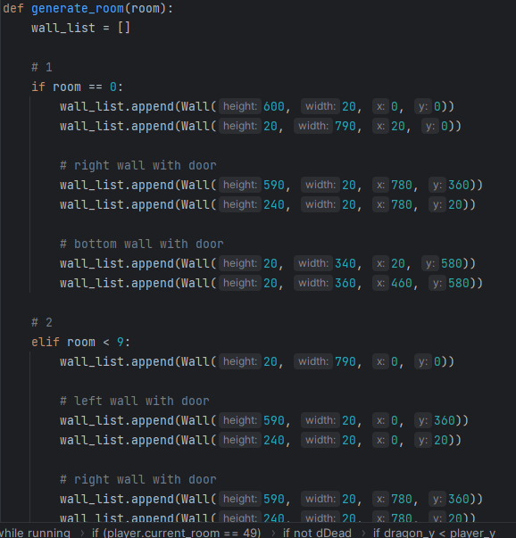
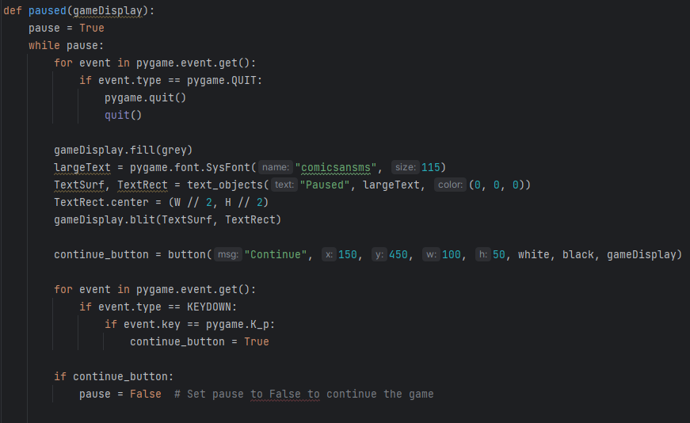
Mechanics and Code Overview
First step of our program is to create all global variables and all other methods that will operate outside the game loop.
Which includes creating the walls in the room, loading the images, method for pausing game, drawing health bars, etc.
Along with player and wall classes

Slide 6
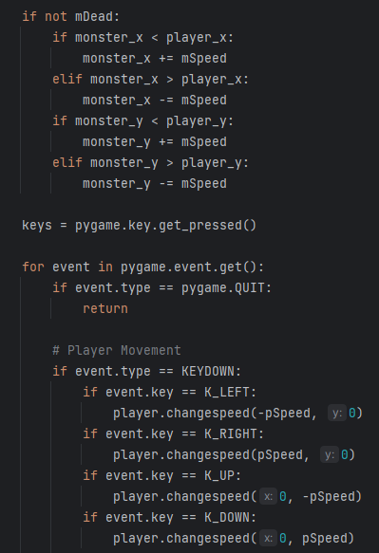
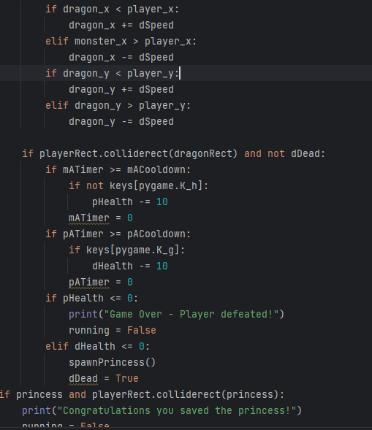
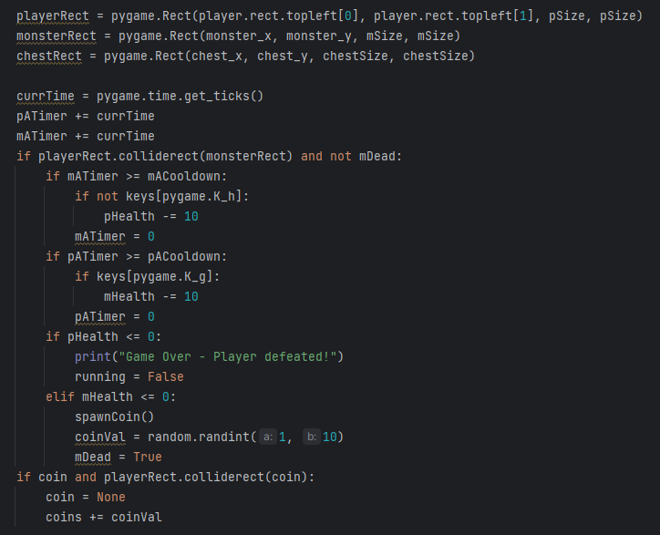
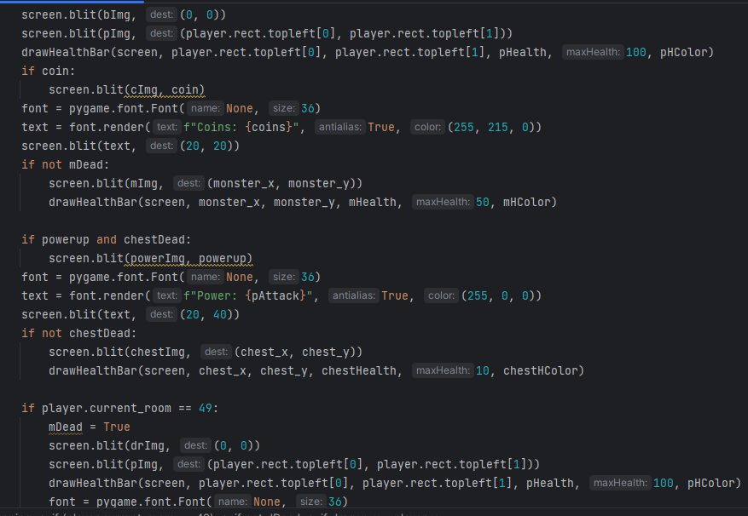
Mechanics and Code Overview
Inside the game loop we have all the movement and collision for the player, monster, boss, coin, chest, and princess. Along with attacking and blocking
This is where we also draw all our items

Slide 7
Challenges
Syncronization and Multiprocessing
Player Movement and in-game Mechanics
This was a big challenge as it took a big amount of time to set up…
Different Monster Entity in each room
Creation of rooms
Collision between all entities was challenging to implement
Changing player speed through powerups

Slide 8
Improvements
Improvements
We started with just one room a player and monster, from there our first improvement was to create an entire dungeon with 50 rooms. Each with its own monster
After our dungeon was created and populated with its monsters, we made it so each time a monster was killed they would drop a random value of coins. At the end of the dungeon, we also added a boss that when killed would drop the princess and when touched would end the game
To round off our project we implemented chests and powerups along with a pause menu and difficulty setting
An actual game engine instead of using pygame would improve the game vastly and development time
Adding animations

Slide 9
Demo

